Slide 1

Learning Style Analysis of Lawrence Technological University Students
Lawrence Technological University (LTU)
Kim Lam, LTU; Sydney Ross, LTU; Justin Light, LTU; Dr. CJ Chung, LTU
2022 MASAL (Michigan Academy of Science, Arts and Letters) Conference, Education Section, Section Chair: Amy Parker, Mar 11, 2022

Slide 2
Overview
Introduction
Hypothesis
Research and Data Collection
What are Learning Styles?
Testing and Results
Student Survey
Machine Learning: Decision Tree Results
Analysis
Learning Styles in LTU Departments
Comparison of Predicted vs Guessed Learning Styles
What makes our study different from others?
Questions
References
Appendix

Slide 3
Introduction
Education is one of the most important aspects in life that can help us shape our future… but in light of the pandemic, students have taken a toll. What can we do to improve education?
Knowing the learning styles of students across each college of Lawrence Technological University (LTU) is very useful to both professors and students
Help professors focus their teaching techniques
Students can increase their productivity while studying
We created a survey and utilized machine learning to automatically predict learning styles
In the data analysis, we found correlations between students study habits, learning styles, and academic research

Slide 4
Hypothesis:
With the knowledge the learning styles of LTU students and recognizing trends amongst each learning style, LTU can better cater to all of its constituents for the most effective academic environment.

Slide 5
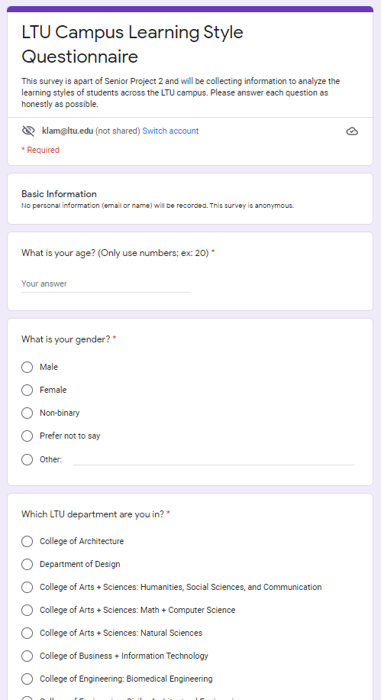
Research and Data Collection
What are Learning Styles?
Definition: A learning style is a preferred way of using one’s abilities to acquire knowledge
The three main categories of learning styles we used in this study are tactile, auditory, and visual.
Data collection:
37 question survey sent out to LTU students (about 150 responders)
Questions included basic student information (not included in the study), study habits, and personality based questions
20 personality questions came from a general online learning style quiz www.educationplanner.org/students/self-assessments/learning-styles-quiz.shtml
The survey results were used to train and predict each student’s learning style

Slide 6
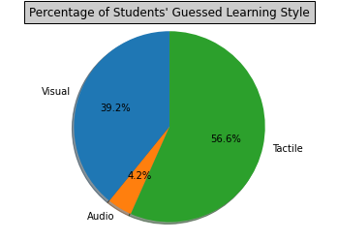
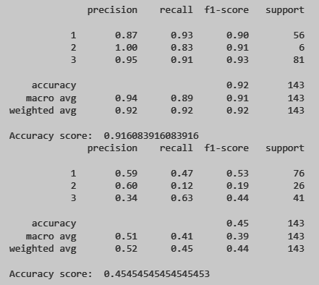
Testing and Results
Student Survey and Machine Learning Results
In the survey, we asked the students to guess their Learning Style (Visual, Auditory, or Tactile)
Sample Personality questions:
What kind of book would you like to read for fun?
When you are not sure how to spell a word, what are you most likely to do?
You're out shopping for clothes, and you're waiting in line to pay. What are you most likely to do while you are waiting?
When you see the word "cat," what do you do first?
What's the best way for you to study for a test?
We tested our data with the following model:
Predictions against Student's own self-guess of their learning style
This model resulted in 89 - 92% accuracy to correctly predict a student’s learning style based on their guess.

Slide 7
Testing and Results
Extra questions we added to our survey
Do you like online learning?
What do you prefer more? (Group work, Individual work, Mix of both?)
How often do you procrastinate?
How often do you get distracted in class/doing homework?
On average, how long is your average attention span? (Answer in number of minutes; ex: 60)
If you need help with homework/studying, what do you go to first?
Do you use online study tools (ex: Chegg, Bartleby, Slader, Symbolab, Wolfram Alpha, any online calculator, etc.)?
What type of online class do you prefer?
Note: Raw data of these questions are at the end of the presentation

Slide 8
Testing and Results
Machine Learning: Decision Tree Results
We tested our data in two ways:
Model 1: Predictions against Student's own self-guess of their learning style
Model 2: Predictions against the mode of just the 20 personality questions
Model 1 resulted in 89 - 92% accuracy to correctly predict a student’s learning style based on their guess.
Model 2 resulted in 43 - 45% accuracy to correctly predict a student’s learning style based on the 20 personality question average.

Slide 9
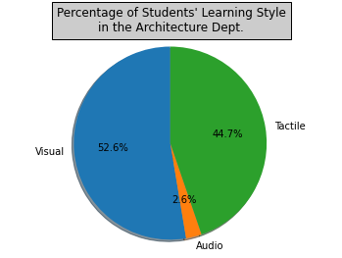
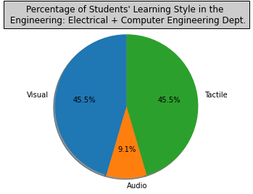
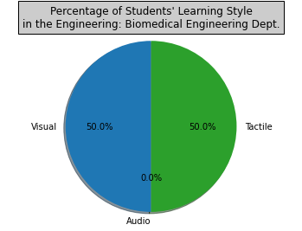
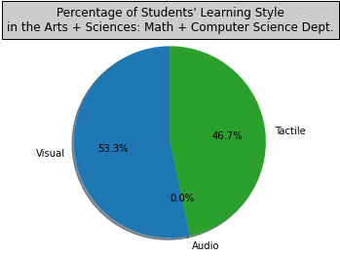
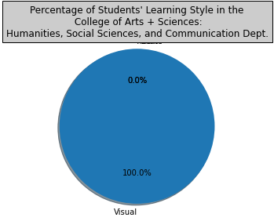
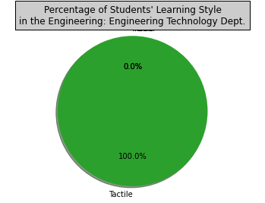
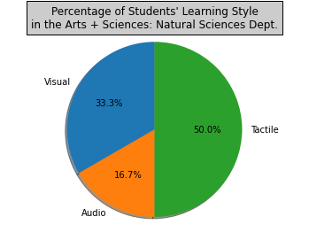
Analysis
Learning Styles in LTU Departments
Grouping each of the results by Department using Model 1 (with the re-run of all sample data)
Interesting learning style majority in some over others

Slide 10
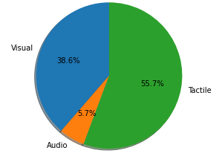
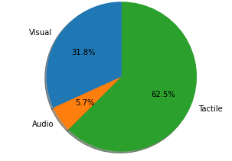
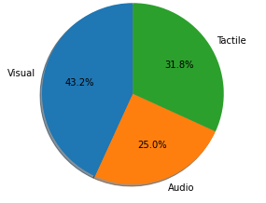
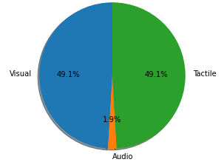
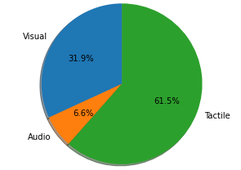
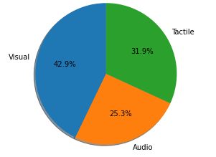
Analysis
Learning Styles in LTU Departments (STEM vs non-STEM)
% of Predicted Styles (using Model)
% of Students’ Own Guess of Style
% of Student’s Styles Based on PQA
STEM Depts.
Non- STEM Depts.

Slide 11
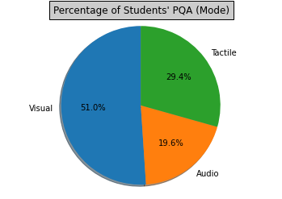
Analysis
Comparison of Predicted vs Guessed Learning Styles
If we look at the comparison of a Student’s guessed Learning styles to the Learning styles the 20 Question personality test gives (Mode), we see a stark difference.
We concluded that:
Using just the 20 Q’s personality test is not enough to accurately determine a student’s learning style
Should take into account student study habits on an individualistic level.
Procrastination
Online Learning Preference
Group work preferences
Attention Span

Slide 12
Final Thoughts
Going back to the Hypothesis
Hypothesis: “With the knowledge the learning styles of LTU students and recognizing trends amongst each learning style, LTU can better cater to all of its constituents for the most effective academic environment.”
Trying to solve the issue of online learning and improving the acquisition of knowledge in students is tough, so by looking into the learning styles of students can be a step forward into the solution.
Future work:
There are some interesting trends that need to be further explored and experimented on to gauge if our hypothesis is correct. We plan to:
Send more surveys out to a larger group of students
Developing an application for all LTU staff and students to use to track academic progress
Compare class learning outcomes between:
classes considering learning styles and other factors
classes not considering learning styles (control group)
Notes:
Procrastination: Visual Learners least likely to b/c they visually need to see progress, while Tactile Learners most likely too b/c they multitask alot and have a short attention span so can forget about things.
Online: Visual and Auditory Learners are favored in online courses (due to use of basic lecturing with slides and speaking), Tactile learners struggle b/c no hands on elements
Group Work: Auditory Learners are best in groups b/c of the vocal discussion format while Visual Learners tend to avoid group work b/c of the loud environment and lack of visual aids (they get distracted)
Attention Span: Tactiles usually have the worst attention span, hard to find a correlation between the highest attention span b/c it really depends on the location and assignment/task that requires the attention.

Slide 13
Thank you!
ANY QUESTIONS?
klam@ltu.edu
sross1@ltu.edu
jlight@ltu.edu
cchung@ltu.edu

Slide 14
Credits and References
Felder, Richard M. “Learning Styles and Strategies.” Andrews University, www.andrews.edu/services/ctcenter/career-center/learning-styles-strategies/learning-styles-and-strategies.pdf. Accessed 18 Feb. 2022.
Gündüz, G.F. (2020). The relationship between academic procrastination behaviors of secondary school students, learning styles and parenting behaviors. International Journal of Contemporary Educational Research, 7(1), 253-266. DOI: https://doi.org/10.33200/ijcer.731976
“How Learning Styles Impact Online Learning.” Penn Foster High School, Penn Foster, 20 Jan. 2016, https://www.pennfoster.edu/blog/2016/january/how-learning-styles-impact-online-learning.
James, Waynne Blue, and Daniel L. Gardner. “Learning Styles: Implications for Distance Learning.” 1995.
Pashler, Harold, et al. “Learning Styles Concepts and Evidence.” SAGE Journals, 1 Dec. 2009, journals.sagepub.com/doi/pdf/10.1111/j.1539-6053.2009.01038.x?casa_token=H8EH-QCoI2kAAAAA:xAm0qGE6jN3dfIclqaSD6m8R7m97QNy9RbhPsGeyAoLGYuFD8Z4KKSt5Nh1xWhLXyEsNJMe3I6qBb04.
Kristyl.barron. “Attitudes toward Procrastination Depend on Learning Style.” The American Genius, 31 May 2013, https://theamericangenius.com/business-news/attitudes-toward-procrastination-depend-on-learning-style/. “Learning Techniques That Fit Best with Your Learning Style.” StudyPug, https://www.studypug.com/blog/kinesthetic-learning-style/.
Martin, P. (2000). The effect of learning styles on project team performance. Paper presented at Project Management Institute Annual Seminars & Symposium, Houston, TX. Newtown Square, PA: Project Management Institute.
Romanelli, Frank, et al. “Learning Styles: A Review of Theory, Application, and Best Practices.” National Center for Biotechnology Information (NCBI), NCBI, 19 Feb. 2009, www.ncbi.nlm.nih.gov/pmc/articles/PMC2690881.
Sarvenaz Hatami, “Learning styles”, ELT Journal, Volume 67, Issue 4, October 2013, Pages 488–490, https://doi.org/10.1093/elt/ccs083
Dawkins, Paul. “Home.” Pauls Online Math Notes, tutorial.math.lamar.edu. Accessed 28 Oct. 2021.
“What’s Your Learning Style? 20 Questions.” Education Planner, Pennsylvania Higher Education Assistance Agency, www.educationplanner.org/students/self-assessments/learning-styles-quiz.shtml. Accessed 10 Dec. 2021.

Slide 15
Appendix
Raw Data from Survey Results

Slide 16
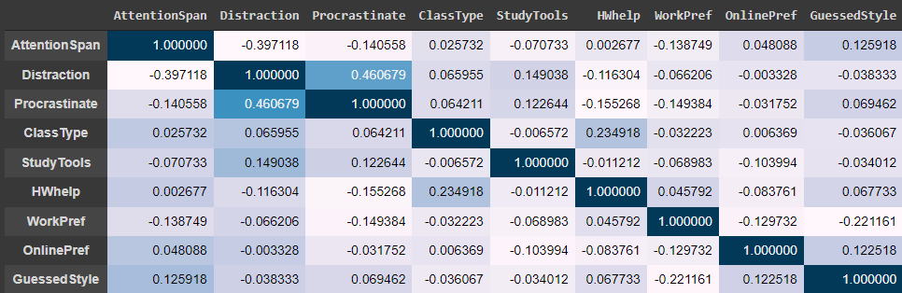
Correlation Chart of Answers Given for the 9 Extra Questions (not part of the 20 Personality Q’s)

Slide 17
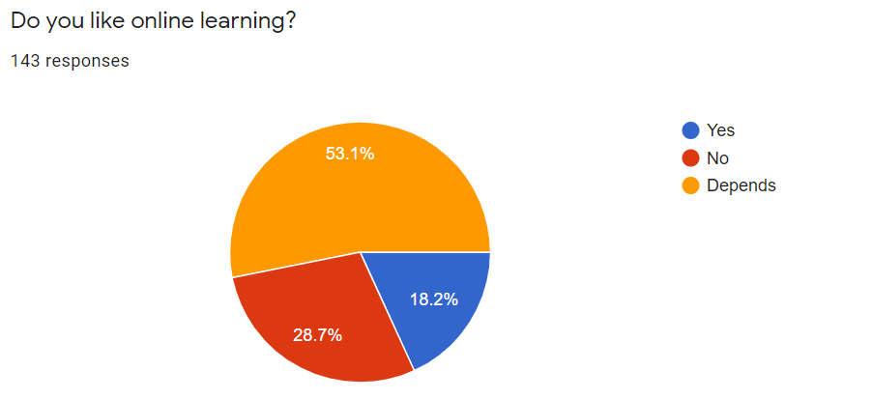
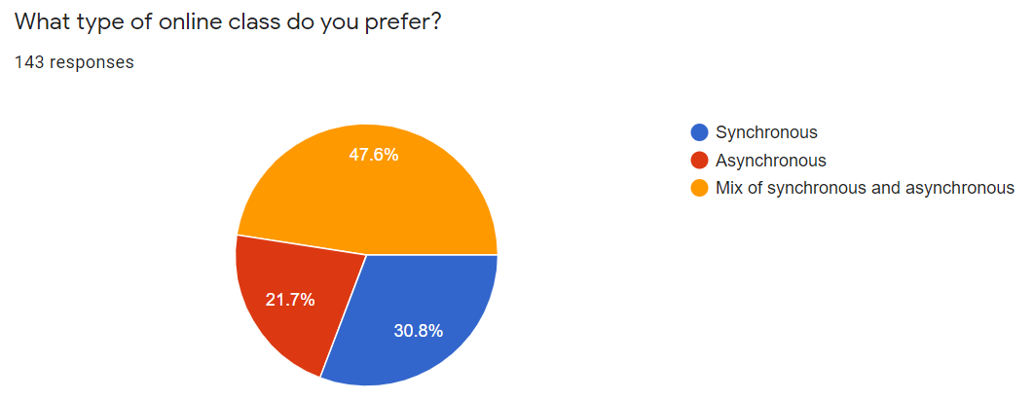
Raw Data on Student’s Opinion of Online Learning

Slide 18
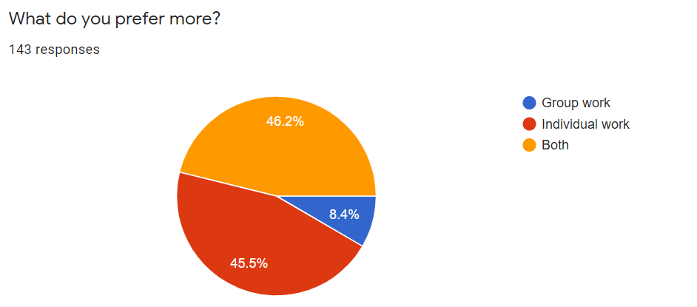
Raw Data on Student’s Opinion of Group/Individual Work

Slide 19
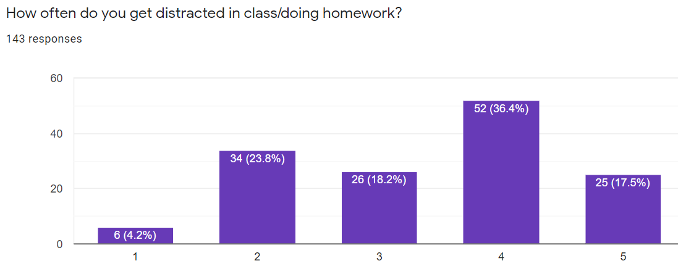
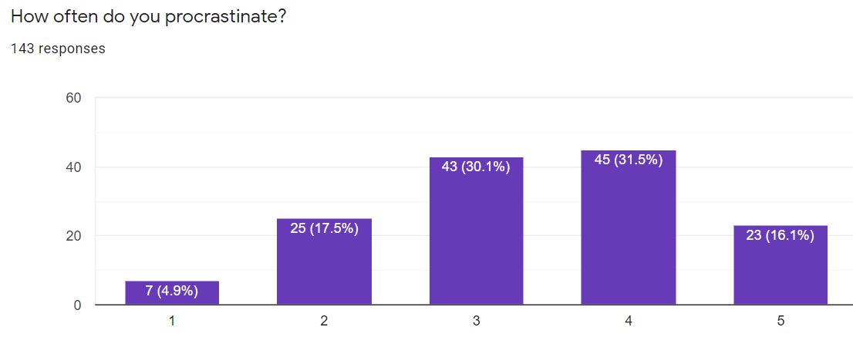
Raw Data on Student’s Opinion of Procrastination and Distractions

Slide 20
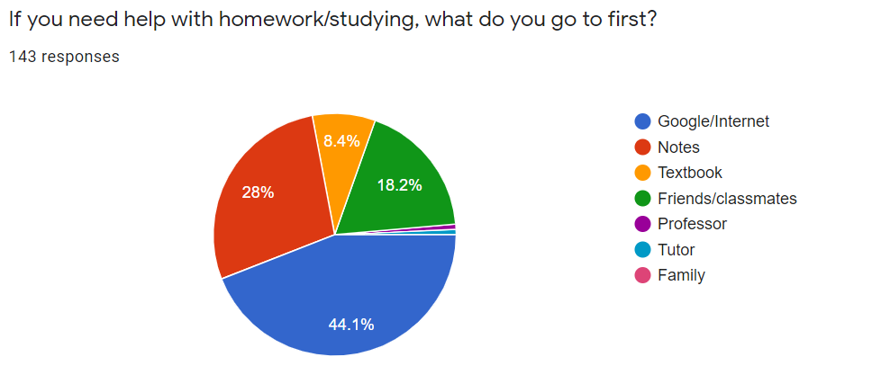
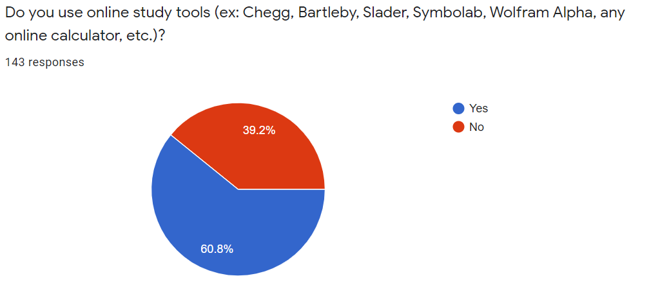
Raw Data on Student’s Opinion of Online Study Tools and General Homework Help Sources

Slide 21
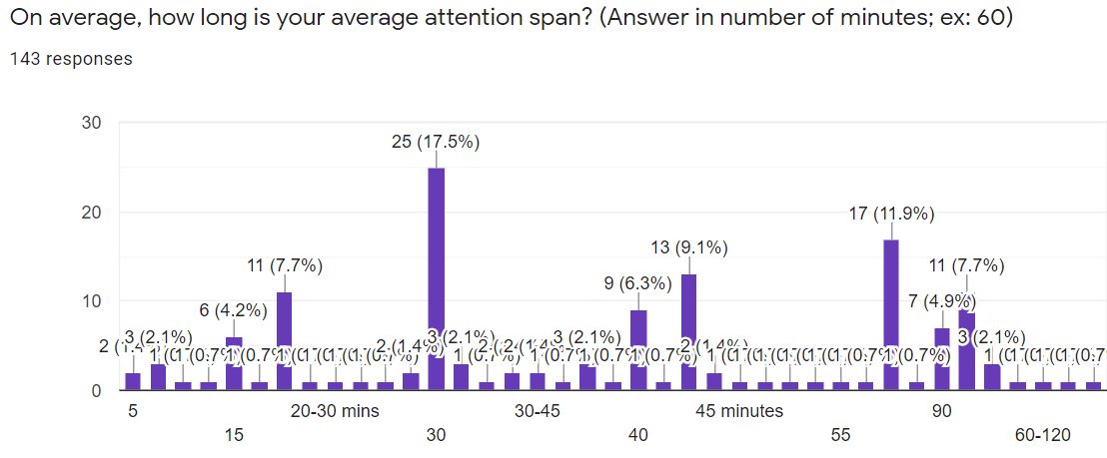
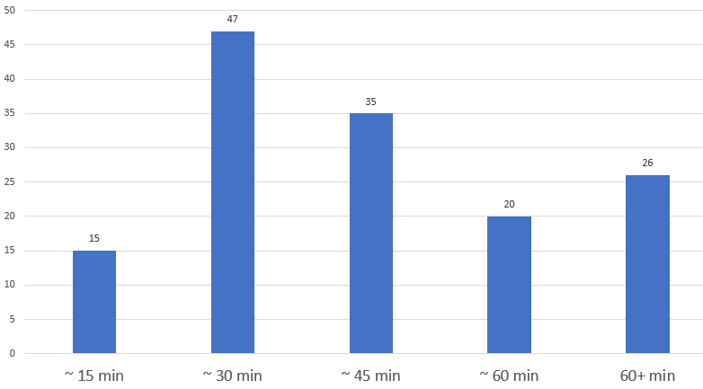
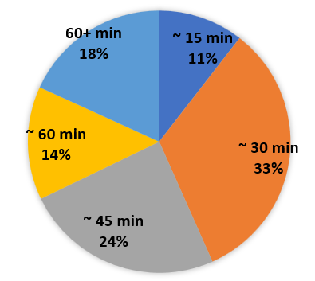
Raw/Converted Data on Student’s Opinion of Average Attention Span

